Slide 1
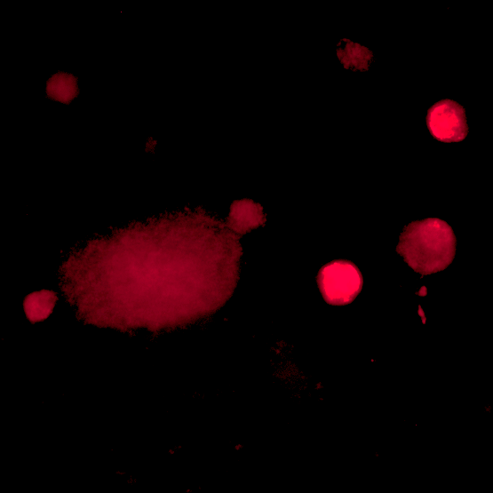
Monitoring PD-L1 Expression on Circulating Stromal Cells in Blood Predicts
PFS and OS in Metastatic NSCLC Patients Treated with PD-L1/PD-1 Immunotherapy
ASCO Annual Meeting , June 6, 2022 Abstract No. 8535
Contact: dan@creatvbio.com
301-983-1650
Jillian A. Moran^{1,3}, Daniel L. Adams¹, Pablo Lopez ², Jianzhong He², Yawei Qiao², Ting Xu², Zhongxing Liao², Kirby P. Gardner^{1,4}, Cha-Mei Tang⁵, Steven H. Lin²
¹ Creatv Bio, Monmouth Junction, NJ 08852, ² MD Anderson Cancer Center, Houston, TX 77030, ³ Rutgers, the State University of New Jersey, New Brunswick, NJ 08901,
⁴ Rutgers University Graduate School of Biomedical Sciences, ⁵ Creatv Bio, Rockville, MD 20850
ABSTRACT
Figure 2. High PD-L1 expression vs Low PD-L1 expression
MATERIALS & METHODS
Cancer Associated Macrophage Like cells (CAMLs), a type of circulating stromal cells, found in the blood of cancer patients (pts), are phagocytic giant macrophages that appear to parallel the real time inflammatory PD-L1 state of the tumor microenvironment. Previously, we demonstrated in local non-small cell lung carcinoma (NSCLC), that the PD-L1 expression on CAMLs is dynamic and can predict response to PD-L1/PD-1 immunotherapies (IMTs) following sequential sampling, and after chemotherapy induction (~30 days) based on progression free survival (PFS) & overall survival (OS). However, this has not been tested in recurrent NSCLC. We monitored PD-L1 expression in CAMLs before and after chemotherapy induction (~30 days) to evaluate CAML’s PD-L1 predictive value in recurrent NSCLC pts treated with or without IMT.
PFS
OS
A single blind multi-year prospective study was undertaken to test the relationship of PD-L1 expression in CAMLs to PFS and OS, pre & post chemotherapy induction in recurrent mNSCLC, with (n=41) or without (n=41) additional anti-PD-L1/PD-1 IMT. This included three IMTs: atezolizumab (n=4), nivolumab (n=8) and pembrolizumab (n=29). We recruited 82 pts with pathologically confirmed recurrent NSCLC prior to treatment for newly recurrent disease. Blood samples (15 mL) were taken at Baseline (BL), prior to chemotherapy, and ~30 days after chemotherapy (T1). Blood was filtered by CellSieve™ filtration & CAMLs’ expression was broken into a binary high or low score, to evaluate PFS and OS hazard ratios (HRs) by censored univariate and multivariate analysis at 24 months.
100%
IMT High PD-L1
IMT Low PD-L1
No IMT High PD-L1
No IMT Low PD-L1
100%
IMT High PD-L1
IMT Low PD-L1
No IMT High PD-L1
No IMT Low PD-L1
75%
75%
Probability of PFS (%)
Probability of OS (%)
n=21
n=14
50%
50%
n=21
n=14
n=16
25%
25%
n=21
n=16
n=21
Merged
CK 8, 18, 19
PD-L1
0%
0
6
12
18
24
0%
0
6
12
18
24
RESULTS
Time (Months)
Time (Months)
CAMLs were found in 97% of all available samples, 94% at BL and 100% at T1
At BL, high PD-L1 in patients not treated with IMT was not significant for PFS (p=0.825) nor OS (p=0.518)
At T1, patients with high PD-L1 in pts not treated with IMT was not significant for PFS (HR=1.10, p=0.937) nor OS (HR=1.75 p=0.298)
At T1, patients with high PD-L1 treated with IMT had significantly better PFS (HR=3.19, p=0.0112), and borderline OS (HR=2.37, p=0.0809)
Patients with increased PD-L1 expression between BL & T1 had significantly better PFS (HR=3.49, p=0.0009) and OS (HR=2.88, p=0.0430)
IMT: HR=3.19, 95%CI=1.4-7.3, p=0.0112
No IMT: HR=1.10, 95%CI=0.5-2.3, p=0.9371
IMT: HR=2.37, 95%CI=1.0-5.6, p=0.0809
No IMT: HR=1.75, 95%CI=0.7-4.2, p=0.2981
CTC
CAML
Figure 3. Change in PD-L1 expression between BL and T1
Figure 1. Example of CTC isolated with a CAML. CTCs are Cytokeratin positive (green) & CD45/CD14 negative. CAMLs are CD45/CD14 positive (not shown), may be weakly positive for Cytokeratin (green) and can express PD-L1 (red). Box is 120 microns.
PFS
OS
100%
IMT Increase PD-L1
IMT No Increase PD-L1
No IMT Increase PD-L1
No IMT No Increase PD-L1
100%
IMT Increase PD-L1
IMT No Increase PD-L1
No IMT Increase PD-L1
No IMT No Increase PD-L1
REFERENCES
75%
75%
Adams DL, et al “Combining circulating tumor cells and circulating cancer associated macrophage-like cells for accurately predicting responsiveness of new line therapies in late stage cancers.” JCO, 36(15) 12032. (2018)
Adams DL, et al. “Sequential tracking of PD-L1 expression and RAD50 induction in circulating tumor and stromal cells of lung cancer patients undergoing radiotherapy” CCR, 23(19) 5948-(2017)
n=10
Probability of PFS (%)
Probability of OS (%)
50%
n=11
50%
n=11
n=16
CONCLUSIONS
25%
n=16
25%
In recurrent NSCLC, high PD-L1 expression in CAMLs is prognostic with IMT use and predicts for response to consolidated IMT after CRT
Monitoring dynamic changes of PD-L1 in CAMLs appears to predict immunotherapy effectiveness in recurrent NSCLC
Updated clinical data for OS is ongoing
Follow up patient subtyping and analysis is ongoing to evaluate PD-L1 in CAML populations.
n=21
n=10
n=21
FUNDING SOURCES
0%
0
6
12
18
24
0%
0
6
12
18
24
This work was supported by a NIH grant R43CA206840
Time (Months)
Time (Months)
IMT: HR=3.49, 95%CI=1.5-8.3, p=0.0009
No IMT: HR=0.84, 95%CI=0.4-2.0, p=0.8569
IMT: HR=2.88, 95%CI=1.2-7.2, p=0.0430
No IMT: HR=2.19, 95%CI=0.8-6.1, p=0.2202
Copyright © 2022 Creatv Bio, all rights reserved

